Slide 1
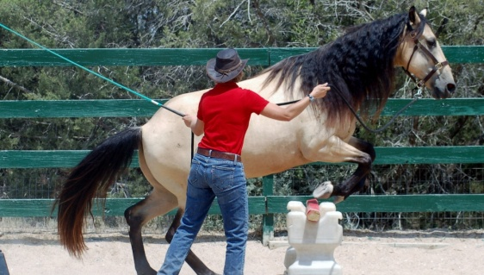
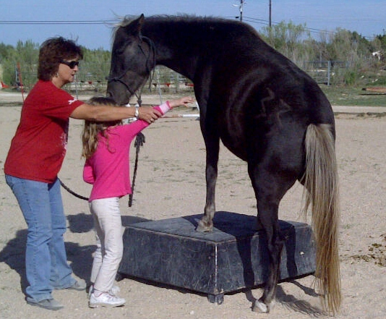
Come Test Your Skills
Your Event Name Here
Come and participate in the fastest growing equine sport
Join Us! Bring Coggins Contact Name Email Address (123) 456 – 7890 | Join us for this wonderful event. Write here what’s great about your event, as well as what they should bring or not bring (any restrictions). Include any special notes or helpful hints for a great event. Tell the reader about the location and what makes it so special. Include any venue fees and the accepted forms of payment. Cash only? Help the attendee be prepared for a great event!
“Martha says it’s the most fun she has had
with her horse in 40 years”
Join Us…
Date
My Event Date Here
Time
My Event Time Here
Location
My Event Location Here
Sponsors
Name 1, Name 2 & Name 3
About Equine Agility
Equine Agility-a non-mounted competitive sport- horse and handler work through an obstacle course in hand for a timed score
Equine Agility emphasizes the relationship between horse and handler, confidence of the horse, willingness, obedience and agility of body and mind

